Slide 1


Business Case
Food Fetch – A Food delivery
A courier service between the restaurants and the customers

Slide 2
Site
Controller
View
Action/Pages
Page 1
Page 2 Etc
Index/Browse
About
Contact
Home
Food Fetch
Log In
Register
Log in/Register
View Orders
Log Out
User
Page 1
Page 2 Etc
Restaurant
Place Order
Order Confirmed
Order
Place Order
Add To Cart

Slide 3
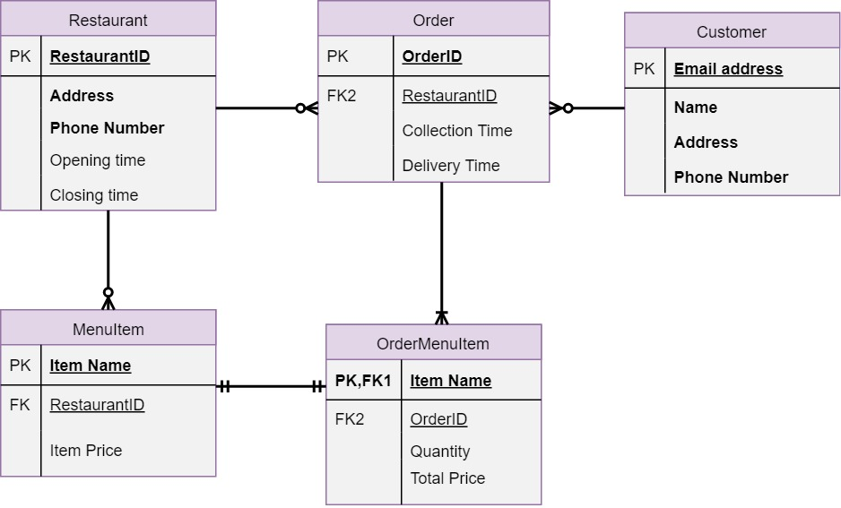

Slide 4
